Slide 1
Chapter 2: Basic Structures: Sets, Functions, Sequences, and Sums (1)
Discrete Mathematics and Its Applications
Lingma Acheson (linglu@iupui.edu)
Department of Computer and Information Science, IUPUI

Slide 2
2.1 Sets
Introduction
Sets are used to group objects together. Often the objects in a set have similar properties.
Data structures: Array, linked list, boolean variables, …
DEFINITION 1
A set is an unordered collection of objects.

Slide 3


2.1 Sets
DEFINITION 2
The objects in a set are called the elements, or members, of the set. A set is
said to contain its elements.
a A: a is an element of the set A.
a A: a is not an element of the set A.
Note: lower case letters are used to denote elements.

Slide 4
2.1 Sets
Ways to describe a set:
  Use { … }
    E.g. {a, b, c, d} – A set with four elements.
      V = {a, e, i, o, u} – The set V of all vowels in English alphabet.
      O = {1, 3, 5, 7, 9} – The set O of odd positive integers less than 10.
      {1, 2, 3, …, 99} – The set of positive integers less than 100.
  Use set builder notation: characterize all the elements in the set by stating the property or properties.
    E.g. O = { x | x is an odd positive integer less than 10}
      O = { x Z⁺| x is odd and x < 10}

Slide 5
2.1 Sets
  Commonly accepted letters to represent sets
    N = {0, 1, 2, 3, …}, the set of natural numbers
    Z = {…, -2, -1, 0, 1, 2, …}, the set of integers
    Z⁺ = {1, 2, 3, …}, the set of positive integers
    Q = {p/q | p Z, q Z, and q ≠ 0}, the set of rational numbers
    R, the set of real numbers
Sets can have other sets as members
  Example: The set {N, Z, Q, R} is a set containing four elements, each of which is a set.

Slide 6


2.1 Sets
DEFINITION 3
Two sets are equal if and only if they have the same elements. That is, if
A and B are sets, then A and B are equal if and only if
x(x A↔ x B).
We write A = B if A and B are equal sets.
Example:
  Are sets {1, 3, 5} and {3, 5,1} equal?
  Are sets {1, 3, 3, 3, 5, 5, 5, 5} and {1, 3, 5} equal?
(The sets {1, 3, 5} and {3, 5, 1} are equal, because they have the same elements. Note that the
order in which the elements of a set are listed does not matter. Note also that it does not matter
if an element of a set is listed more than once, so {1, 3, 3, 3, 5, 5, 5, 5} is the same as the set
{1, 3, 5} because they have the same elements.)

Slide 7
2.1 Sets
Venn Diagrams
  Represent sets graphically
  The universal set U, which contains all the objects under consideration, is represented by a rectangle. The set varies depending on which objects are of interest.
  Inside the rectangle, circles or other geometrical figures are used to represent sets.
  Sometimes points are used to represent the particular elements of the set.
U
a
u
V
e
o
i

Slide 8
2.1 Sets
Empty Set (null set): a set that has no elements, denoted by ф or {}.
Example: The set of all positive integers that are greater than their squares is an empty set.
Singleton set: a set with one element
Compare: ф and {ф}
  Ф: an empty set. Think of this as an empty folder
  {ф}: a set with one element. The element is an empty set. Think of this as an folder with an empty folder in it.

Slide 9

2.1 Sets
DEFINITION 4
The set A is said to be a subset of B if and only if every element of A is
also an element of B. We use the notation A B to indicate that A is a
subset of the set B.
A B if and only if the quantification
  x(x A → x B) is true
U
A
B

Slide 10


2.1 Sets
Every non-empty set S is guaranteed to have at least two subset, the empty set and the set S itself, that is ф S and S S.
If A is a subset of B but A ≠ B, then A B or A is a proper subset of B.
For A B to be true, it must be the case that A B and there must exist an element x of B that is not an element of A, i.e.
x(x A → x B) Λ x(x B x A)
THEOREM 1
For every set S,
(i) ф S and (ii) S S

Slide 11
2.1 Sets
DEFINITION 5
Let S be a set. If there are exactly n distinct(নির্দিষ্ট) elements in S where n is a
nonnegative integer, we say that S is a finite(সসীম) set and that n is the
Cardinality(cardinal=প্রধান) of S. The cardinality of S is denoted by |S|.
Example:
  Let A be the set of odd positive integers less than 10. Then |A| = 5.
  Let S be the set of letters in the English alphabet. Then |A| = 26.
  Null set has no elements, | ф | = 0.

Slide 12
2.1 Sets
DEFINITION 6
A set is said to be infinite if it is not finite.
Example: The set of positive integers is infinite.

Slide 13
2.1 Sets
DEFINITION 7
Given a set, the power set of S is the set of all subsets of the set S. The
power set of S is denoted by P(S).
Example:
  What is the power set of the set {0,1,2}?
  Solution: P({0,1,2}) = {ф, {0}, {1}, {2}, {0,1}, {0,2}, {1,2}, {0,1,2}}
  What is the power set of the empty set? What is the power set of the set {ф}?
  Solution: The empty set has exactly one subset, namely, itself.
  P(ф ) = {ф}
  The set {ф} has exactly two subsets, namely, ф and the set {ф}.
  P({ф}) = {ф, {ф}}
If a set has n elements, its power set has 2^{n} elements.

Slide 14
2.1 Sets
Cartesian Products
Sets are unordered, a different structure is needed to represent an ordered collections – ordered n-tuples.
Two ordered n-tuples are equal if and only if each corresponding pair of their elements is equal.
  (a₁, a₂,…, a_{n}) = (b₁, b₂,…, b_{n}) if and only if a_{i} = b_{i} for i = 1, 2, …, n
DEFINITION 8
The ordered n-tuple (a₁, a₂,…, a_{n}) is the ordered collection that has a₁
as its first element, a₂ as its second element, …, and a_{n} as its nth
element.

Slide 15
2.1 Sets
DEFINITION 9
Let A and B be sets. The Cartesian product of A and B, denoted by A ×
B, is the set of all ordered pairs (a, b), where a A and b B. Hence,
A × B = {(a,b)| a A Λ b B}.
Example:
What is the Cartesian product of A = {1,2} and B = {a,b,c}?
Solution:
A × B = {(1,a), (1,b), (1,c), (2,a), (2,b), (2,c)}
Cartesian product of A × B and B × A are not equal, unless A = ф or B = ф (so that A × B = ф ) or A = B.
B × A = {(a,1),(a,2),(b,1),(b,2),(c,1),(c,2)}

Slide 16
2.1 Sets
DEFINITION 10
The Cartesian product of sets A₁, A₂, …, A_{n}, denoted by A₁ × A₂ × …
× A_{n} is the set of ordered n-tuples (a₁, a₂, …, a_{n}), where a_{i} belongs to
A_{i} for i = 1,2, …, n. In other words,
A₁ × A₂ × … × A_{n} = {(a₁, a₂, …, a_{n}) | a_{i} A_{i} for i = 1,2, …, n}.
Example:
What is the Cartesian product of A × B × C where A= {0,1}, B = {1,2}, and C = {0,1,2}?
Solution:
A × B × C= {(0,1,0), (0,1,1), (0,1,2), (0,2,0), (0,2,1), (0,2,2), (1,1,0), (1,1,1), (1,1,2), (1,2,0), (1,2,1), (1,2,2)}

Slide 17
2.2 Set Operations
Definition 1: The union of the sets A and B, denoted by A∪B, is the set containing those elements that are either in A or in B, or in both.
  A∪B={x|x∈A ∨ x∈B}
Definition 2: The intersection of the sets A and B, denoted by A∩B, is the set containing those elements in both A and B.
  A ∩ B={x|x∈A ∧ x∈B}

Slide 18
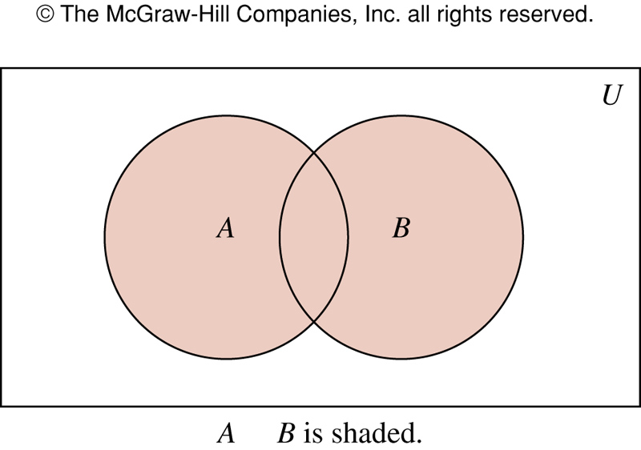

Figure 1 (2.2)
∪
FIGURE 1 Venn Diagram Representing the Union of A and B.
歐亞書局
P. 122
Notes:
p:\msoffice\My Projects\Rosen 6e 2007\Imagebank\JPEGs07-24-06\ch02\jpeg\02_2_001.jpg

Slide 19
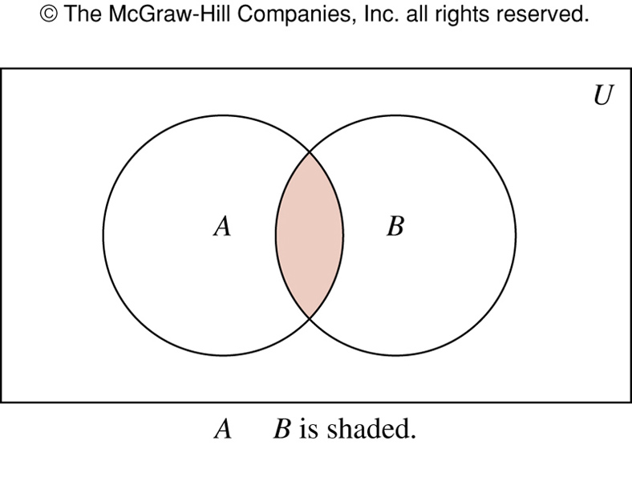
FIGURE 2 (2.2)
∩
FIGURE 2 Venn Diagram Representing the Intersection of A and B.
歐亞書局
P. 122
Notes:
p:\msoffice\My Projects\Rosen 6e 2007\Imagebank\JPEGs07-24-06\ch02\jpeg\02_2_002.jpg

Slide 20
Set Operation: Disjoint
Definition 3: Two sets are disjoint if their intersection is the empty set.
|A∪B|=|A|+|B|-| A ∩ B |
  Principle of inclusion-exclusion

Slide 21
Set operations: Difference
Definition 4: The difference of the sets A and B, denoted by A-B, is the set containing those elements that are in A but not in B.
  Complement of B with respect to A
  A-B={x|x∈A ∧ x∉B}

Slide 22
Set operations: Difference
Formal definition for the difference of two sets:
A - B = { x | x ∈ A and x ∉ B }
A - B = A ∩ B ← Important!
Further examples
  {1, 2, 3} - {3, 4, 5} = {1, 2}
  {New York, Washington} - {3, 4} = {New York, Washington}
  {1, 2} - ∅ = {1, 2}
    The difference of any set S with the empty set will be the set S
_

Slide 23
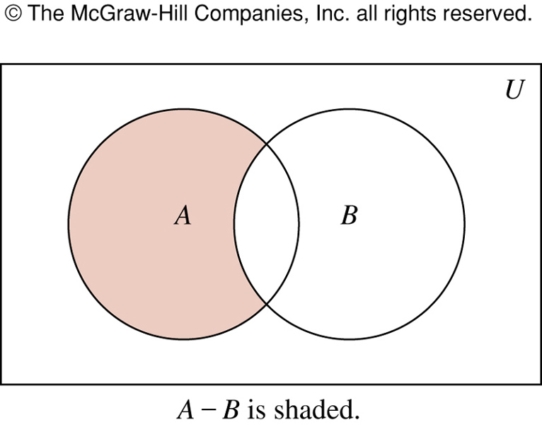
FIGURE 3 (2.2)
FIGURE 3 Venn Diagram for the Difference of A and B.
歐亞書局
P. 123
Notes:
p:\msoffice\My Projects\Rosen 6e 2007\Imagebank\JPEGs07-24-06\ch02\jpeg\02_2_003.jpg

Slide 24
Set operations: Symmetric Difference 2
Formal definition for the symmetric difference of two sets:
A ⊕ B = { x | (x ∈ A or x ∈ B) and x ∉ A ∩ B}
A ⊕ B = (A U B) – (A ∩ B) ← Important!
Further examples
  {1, 2, 3} ⊕ {3, 4, 5} = {1, 2, 4, 5}
  {New York, Washington} ⊕ {3, 4} = {New York, Washington, 3, 4}
  {1, 2} ⊕ ∅ = {1, 2}
    The symmetric difference of any set S with the empty set will be the set S

Slide 25
Set Operation: Complement
Definition 5: The complement of the set A, denoted by Ā, is the complement of A with resepect to U.
  Ā = {x|x∉A}

Slide 26
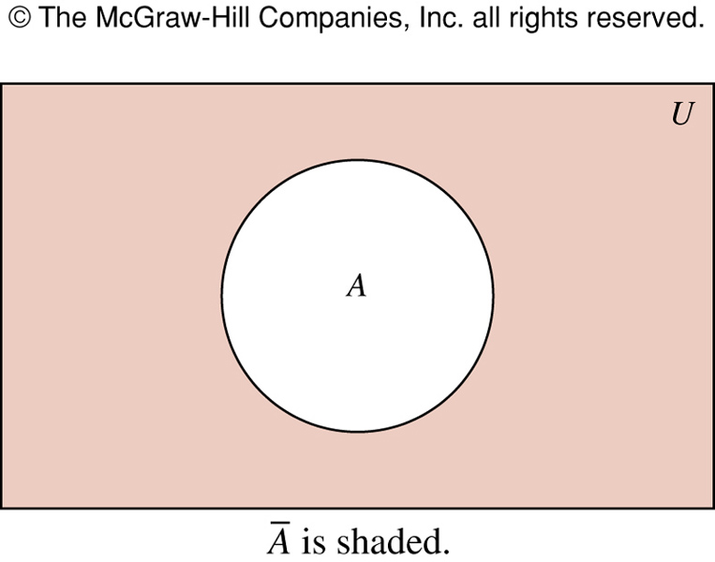
FIGURE 4 (2.2)
FIGURE 4 Venn Diagram for the Complement of the Set A.
歐亞書局
P. 123
Notes:
p:\msoffice\My Projects\Rosen 6e 2007\Imagebank\JPEGs07-24-06\ch02\jpeg\02_2_004.jpg

Slide 27
Set identities
Set identities are basic laws on how set operations work
  Many have already been introduced on previous slides
Just like logical equivalences!
  Replace U with ∨
  Replace ∩ with ∧
  Replace ∅ with F
  Replace U with T
Full list on Rosen, page 89

Slide 28
How to prove a set identity
For example: A∩B=B-(B-A)
Four methods:
  Use the basic set identities
  Use membership tables
  Prove each set is a subset of each other
    This is like proving that two numbers are equal by showing that each is less than or equal to the other
  Use set builder notation and logical equivalences

Slide 29
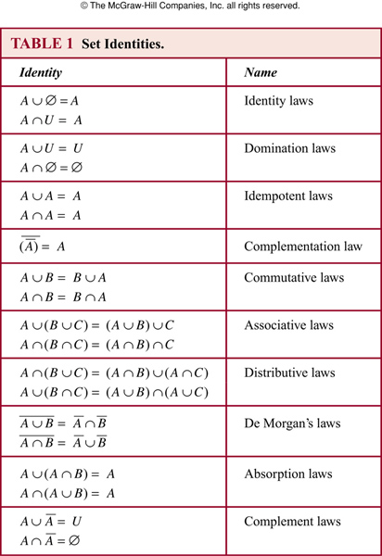
TABLE 1 (2.2)
歐亞書局
P. 124
Notes:
p:\msoffice\My Projects\Rosen 6e 2007\Imagebank\JPEGs07-24-06\ch02\jpeg\t02_2_01.jpg

Slide 30




Two sets X and Y are equal if X and Y have the same elements.
To prove sets X and Y are equal, prove if
then , and if , then

Slide 31
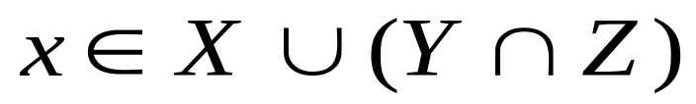







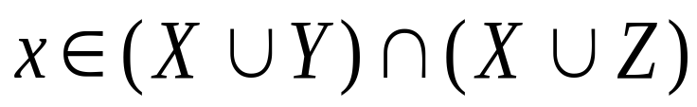
Example: Determine the truth value of
Proof: Let . Then x is a member of X, or x is a member of . Hence, x is a member of X, or x is a member of Y and x is a member of Z. If x is a member of X, then x is a member of and x is a member of .
Otherwise, x is a member of Y and Z and hence a member of and . Either way, x is a member of and . Therefore,
.
Now show the other direction.

Slide 32
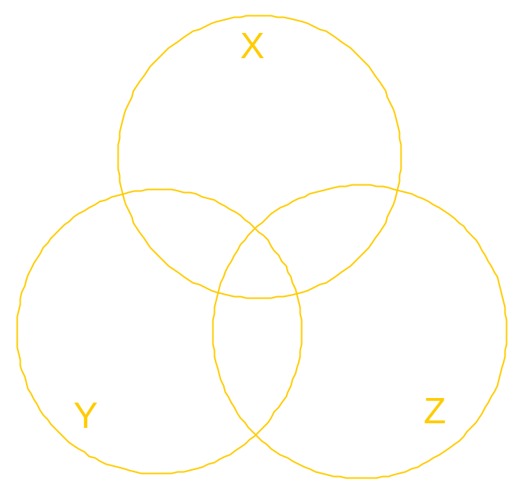
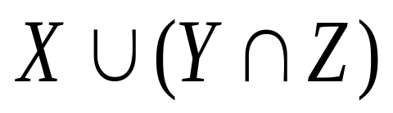
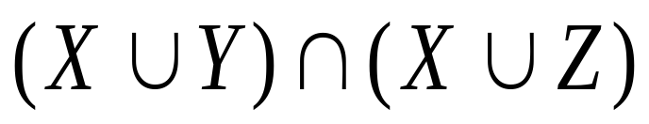
Venn Diagram Verification
X
Y
Z

Slide 33
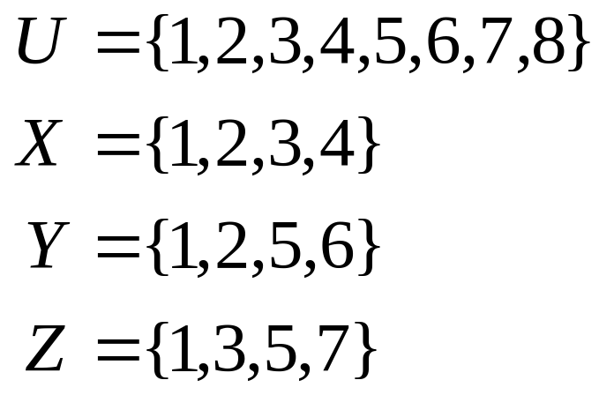
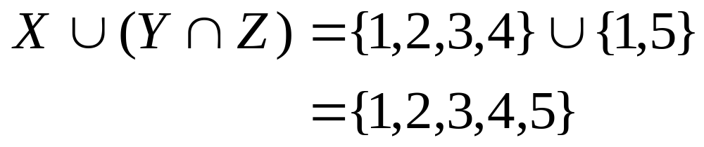
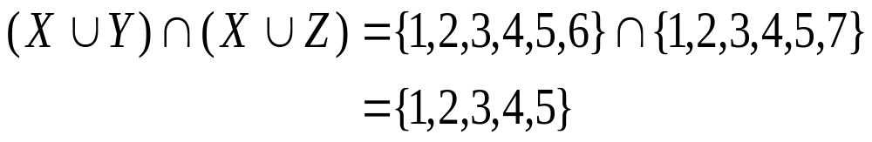
4
2 1 3
6 5 7
8

Slide 34





Membership Tables
1
2
3
4
5
6
7
8
X | Y | Z
1 | 1 | 1 | 1 | 1 | 1 | 1 | 1
1 | 1 | 0 | 0 | 1 | 1 | 1 | 1
1 | 0 | 1 | 0 | 1 | 1 | 1 | 1
1 | 0 | 0 | 0 | 1 | 1 | 1 | 1
0 | 1 | 1 | 1 | 1 | 1 | 1 | 1
0 | 1 | 0 | 0 | 0 | 1 | 0 | 0
0 | 0 | 1 | 0 | 0 | 0 | 1 | 0
0 | 0 | 0 | 0 | 0 | 0 | 0 | 0

Slide 35
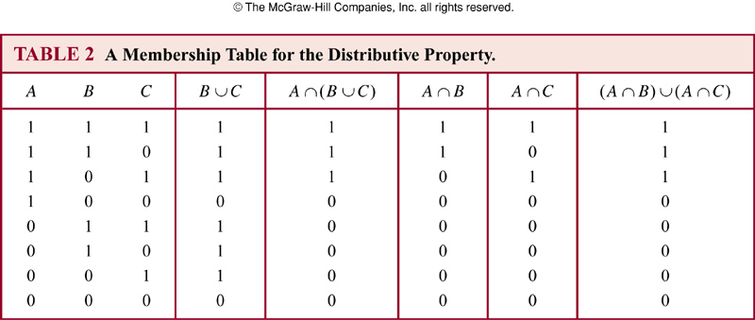
TABLE 2 (2.2)
歐亞書局
P. 126
Notes:
p:\msoffice\My Projects\Rosen 6e 2007\Imagebank\JPEGs07-24-06\ch02\jpeg\t02_2_02.jpg

Slide 36
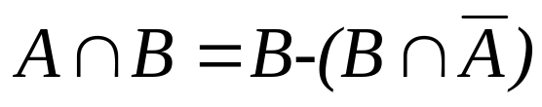
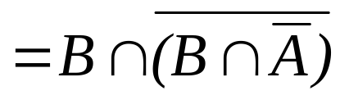
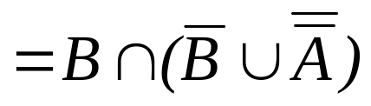
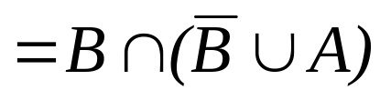
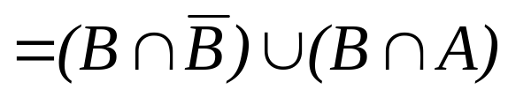



Proof by using basic set identities
Prove that A∩B=B-(B-A)
Definition of difference
Definition of difference
DeMorgan’s law
Complementation law
Distributive law
Complement law
Identity law
Commutative law

Slide 37
Proof by set builder notation and logical equivalences 1
First, translate both sides of the set identity into set builder notation
Then massage one side (or both) to make it identical to the other
  Do this using logical equivalences

Slide 38








Proof by set builder notation and logical equivalences 2
Original statement
Definition of difference
Negating “element of”
Definition of difference
DeMorgan’s Law
Distributive Law
Negating “element of”
Negation Law
Identity Law
Definition of intersection

Slide 39

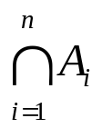
Generalized Unions and Intersections
Definition 6: The union of a collection of sets is the set containing those elements that are members of at least one set in the collection.
  A₁∪ A₂ ∪ … ∪ A_{n} =
Definition 7: The intersection of a collection of sets is the set containing those elements that are members of all the sets in the collection.
  A₁∩ A₂ ∩ … ∩ A_{n} =
Computer Representation of Sets
  Using bit strings

Slide 40
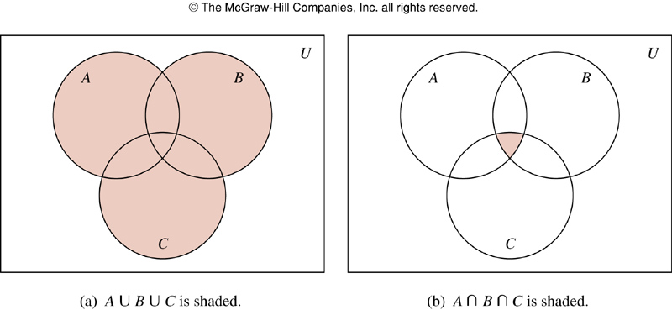
FIGURE 5 (2.2)
FIGURE 5 The Union and Intersection of A, B, and C.
歐亞書局
P. 127
Notes:
p:\msoffice\My Projects\Rosen 6e 2007\Imagebank\JPEGs07-24-06\ch02\jpeg\02-2-005.jpg

Slide 41
Computer representation of sets 1
Assume that U is finite (and reasonable!)
  Let U be the alphabet
Each bit represents whether the element in U is in the set
The vowels in the alphabet:
abcdefghijklmnopqrstuvwxyz
10001000100000100000100000
The consonants in the alphabet:
abcdefghijklmnopqrstuvwxyz
01110111011111011111011111

Slide 42
Computer representation of sets 2
Consider the union of these two sets:
    10001000100000100000100000
    ∨01110111011111011111011111
    11111111111111111111111111
Consider the intersection of these two sets:
    10001000100000100000100000
    ∧01110111011111011111011111
    00000000000000000000000000

Slide 43
Function

Slide 44
Definition of a Function
Idea:
f
Image of x under f
x
f(x)
Argument
x
f
y
Independent variable
Dependent variable

Slide 45
2.3 Functions
Definition 1: A function f is a rule that associates with each input x a unique [“exactly one”] output y or {f(x)}
Definition 2: A function f from A to B is an assignment of exactly one element of B to each element of A. f: A→B
Definition 3: f: A→B. [A and B are two sets]
  A: domain of f, B: codomain of f.
  f(a)=b, a: preimage of b, b: image of a.
  Range of f: the set of all images of elements of A
  f: maps A to B

Slide 46
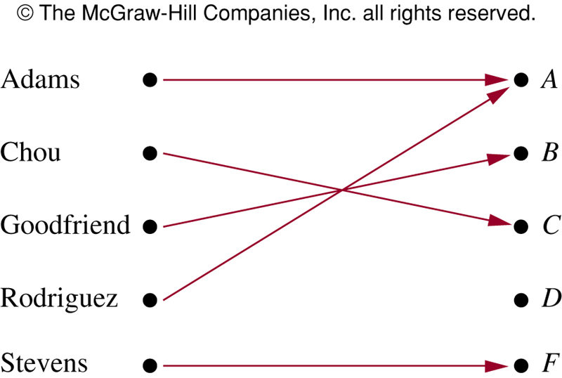
FIGURE 1 (2.3)
FIGURE 1 Assignment of Grades in a Discrete Mathematics Class.
歐亞書局
P. 133
Notes:
p:\msoffice\My Projects\Rosen 6e 2007\Imagebank\JPEGs07-24-06\ch02\jpeg\02-3-001.jpg

Slide 47
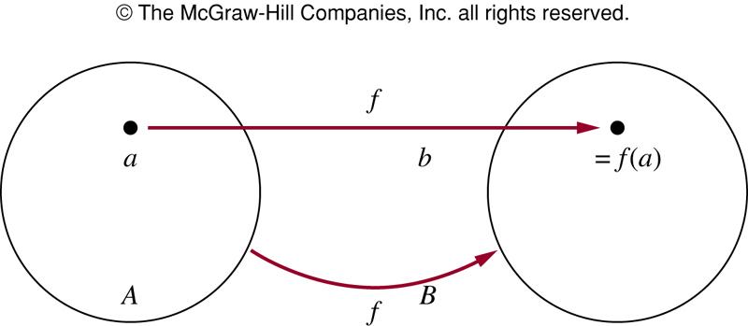
FIGURE 2 (2.3)
FIGURE 2 The Function f Maps A to B.
歐亞書局
P. 134
Notes:
p:\msoffice\My Projects\Rosen 6e 2007\Imagebank\JPEGs07-24-06\ch02\jpeg\02-3-002.jpg

Slide 48
Definition 4: Let f₁ and f₂ be functions from A to R. f₁+f₂ and f₁f₂ are also functions from A to R:
  (f₁+f₂)(x) = f₁(x)+f₂(x)
  (f₁f₂)(x)=f₁(x)f₂(x)

Slide 49
One-to-One and Onto Functions
Definition 5: A function f is one-to-one or injective, iff f(a)=f(b) implies that a=b for all a and b in the domain of f.
  ∀a∀b( f(a)=f(b) → a=b ) or
  ∀a∀b( a ≠ b → f(a) ≠ f(b) )
Definition 6: A function f is increasing if f(x)≤f(y), and strictly increasing if f(x)<f(y) whenever x<y. f is called decreasing if f(x)≥f(y), and strictly decreasing if f(x)>f(y) whenever x<y.

Slide 50
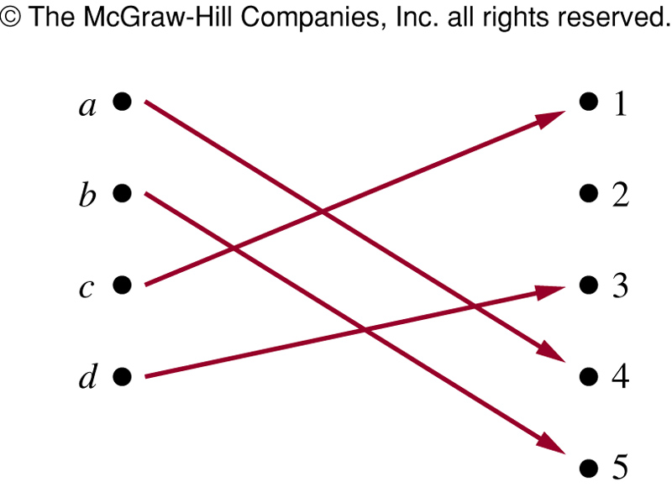
FIGURE 3 (2.3)
FIGURE 3 A One-to-One Function.
歐亞書局
P. 137
Notes:
p:\msoffice\My Projects\Rosen 6e 2007\Imagebank\JPEGs07-24-06\ch02\jpeg\02-3-003.jpg

Slide 51
Representation of a function
A function can be represented in several different forms such as:
  Table of values
  A graph
  An algebraic formula
  Words
In each case a function must be absolutely predictable
  An input always has exactly one and the same output.
Example of a function given by a formula
  f(x)=3x² – 4x+2 or y= 3x² – 4x+2
  f(-1)=9 = (-1,9)
input
output

Slide 52
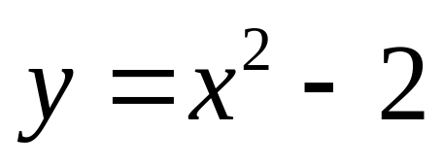
Graphing an Equation as Function
To sketch the graph an equation in x and y, we need to find ordered pairs that solve the equation and plot the ordered pairs on a grid. This process is called point-by-point plotting.
For example, let’s plot the graph of the equation

Slide 53
Graphing an Equation:
Making a Table of Ordered Pairs
Make a table of ordered pairs that satisfy the equation
x | y
–3 | (–3)²+2 = 11
–2 | (–2)²+2 = 6
–1 | (–1)²+2 = 6
0 | (0)²+2 = 2
1 | (1)²+2 = 3
2 | (2)²+2 = 6

Slide 54
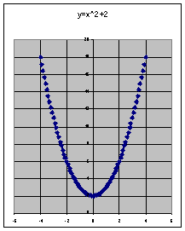
Graphing an Equation:
Plotting the points
Next, plot the points and connect them with a smooth curve. You may need to plot additional points to see the pattern formed.

Slide 55
Functions Specified by Equations
If in an equation in two variables, we get exactly one output (value for the dependent variable) for each input (value for the independent variable), then the equation specifies a function. The graph of such a function is just the graph of the specifying equation.
If we get more than one output for a given input, the equation does not specify a function.

Slide 56
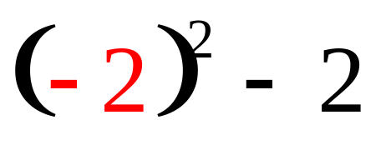
Functions Specified by Equations
Consider the equation that was graphed on a previous slide
Input:
x = –2
–2
Process:
square (–2),
then subtract 2
(–2,2) is an ordered pair of the function.
Output:
result is 2
2

Slide 57
Vertical Line Test for a Function
If you have the graph of an equation, there is an easy way to determine if it is the graph of an function. It is called the vertical line test which states that:
An equation specifies a function if each vertical line in the coordinate system passes through at most one point on the graph of the equation.
If any vertical line passes through two or more points on the graph of an equation, then the equation does not specify a function.

Slide 58
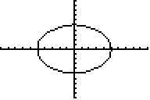
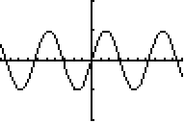
Vertical Line Test for a Function
(continued)
This graph is not the graph of a function because you can draw a vertical line which crosses it twice.
This is the graph of a function because any vertical line crosses only once.

Slide 59

Absolute Value Function
Absolute values are identically same
-x is not negative here; as x is negative therefore –x is positive here.
2
-2
2

Slide 60
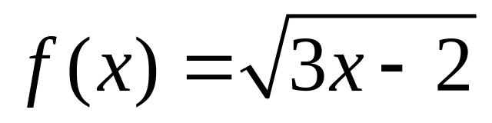
Find the domain of a function
Example:
  f(x)=x³ Domain of f = all real number R
  f(x)=1/(x-1)(x-3) Domain of f is all real number except 1 and 3

Slide 61
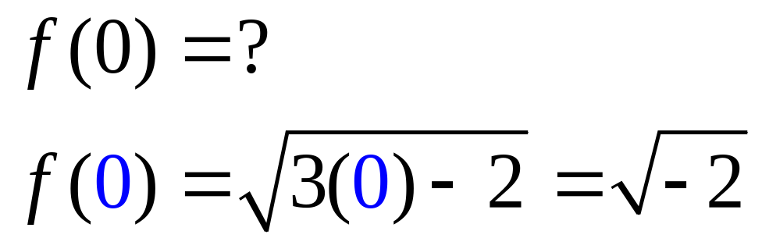
Domain of a Function
Consider
which is not a real number.
Question: for what values of x is the function defined?

Slide 62
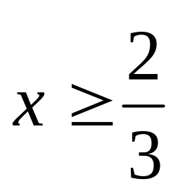
Domain of a Function
Answer:
is defined only when the radicand (3x – 2) is equal to or greater than zero. This implies that

Slide 63
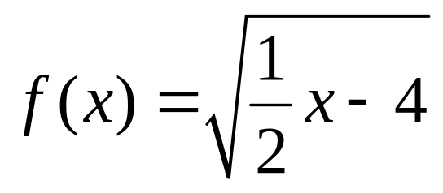
Domain of a Function
(continued)
Therefore, the domain of our function is the set of real numbers that are greater than or equal to 2/3.
Example: Find the domain of the function

Slide 64
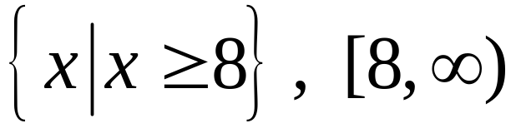
Domain of a Function
(continued)
Therefore, the domain of our function is the set of real numbers that are greater than or equal to 2/3.
Example: Find the domain of the function
Answer:

Slide 65
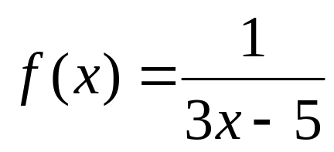
Domain of a Function:
Another Example
Find the domain of

Slide 66
Domain of a Function:
Another Example
Find the domain of
In this case, the function is defined for all values of x except where the denominator of the fraction is zero. This means all real numbers x except 5/3.

Slide 67
Usual reasons to restrict a Domain
Avoid division by 0
Avoid even roots of negative numbers
Meet the condition of an applied problem.
    The length or an area; those number has to be non negetive.

Slide 68
Properties of functions (One to One)
A function is called one to one or (injection) if different elements in the domain are related to different elements in the range.
a
b
c
d
e
1
2
3
4
5
6
7

Slide 69
Properties of functions
A function is called onto or a surjection if each element of the range is related to at least one element in the domain.
a
b
c
d
e
f
1
2
3
4
5

Slide 70
Properties of functions
A function is called bijection if it is one to one onto
For each element in the domain there is one and only one element in the range
Number of elements in the domain equals that in the range
a
b
c
d
e
1
2
3
4
5

Slide 71
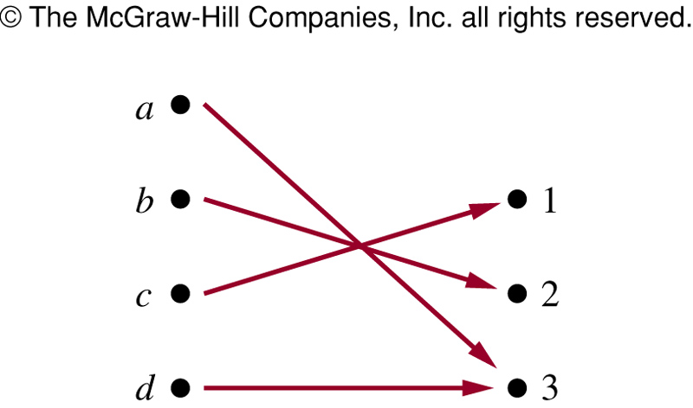
FIGURE 4 (2.3)
FIGURE 4 An Onto Function.
歐亞書局
P. 138
Notes:
p:\msoffice\My Projects\Rosen 6e 2007\Imagebank\JPEGs07-24-06\ch02\jpeg\02-3-004.jpg

Slide 72
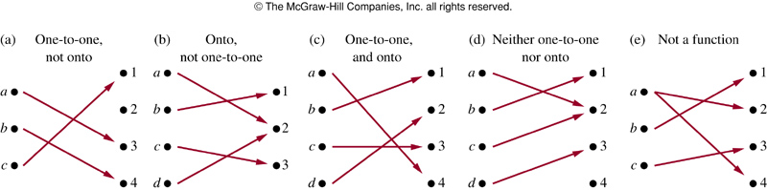
FIGURE 5 (2.3)
FIGURE 5 Examples of Different Types of Correspondences.
歐亞書局
P. 139
Notes:
p:\msoffice\My Projects\Rosen 6e 2007\Imagebank\JPEGs07-24-06\ch02\jpeg\02-3-005.jpg

Slide 73
Inverse Functions and Compositions of Functions
Definition 9: Let f be a one-to-one correspondence from A to B. The inverse function of f is the function that assigns to an element b in B the unique element a in A such that f(a)=b.
  f⁻¹(b)=a when f(a)=b

Slide 74
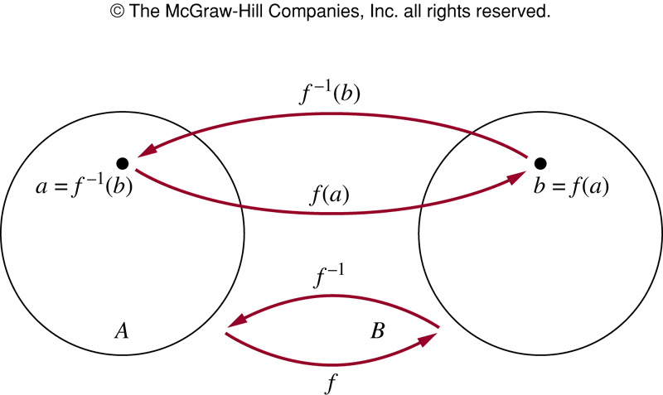
FIGURE 6 (2.3)
FIGURE 6 The Function f ^{－1} Is the Inverse of Function f.
歐亞書局
P. 139
Notes:
p:\msoffice\My Projects\Rosen 6e 2007\Imagebank\JPEGs07-24-06\ch02\jpeg\02-3-006.jpg

Slide 75
Definition 10: Let g be a function from A to B, and f be a function from B to C. The composition of functions f and g, denoted by f○g, is defined by:
  f○g(a) = f(g(a))
  f○g and g○f are not equal

Slide 76
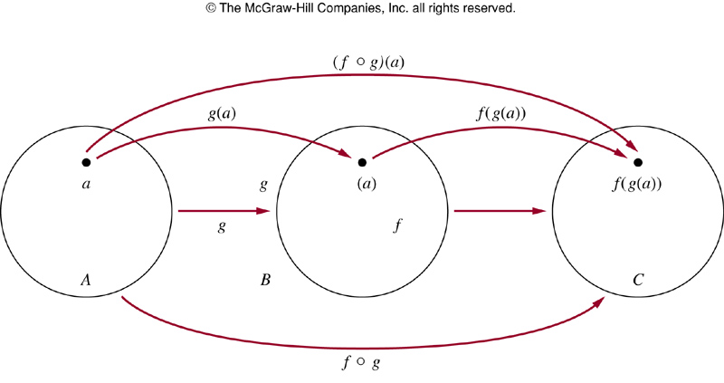
FIGURE 7 (2.3)
FIGURE 7 The Composition of the Functions f and g.
歐亞書局
P. 141
Notes:
p:\msoffice\My Projects\Rosen 6e 2007\Imagebank\JPEGs07-24-06\ch02\jpeg\02-3-007.jpg

Slide 77
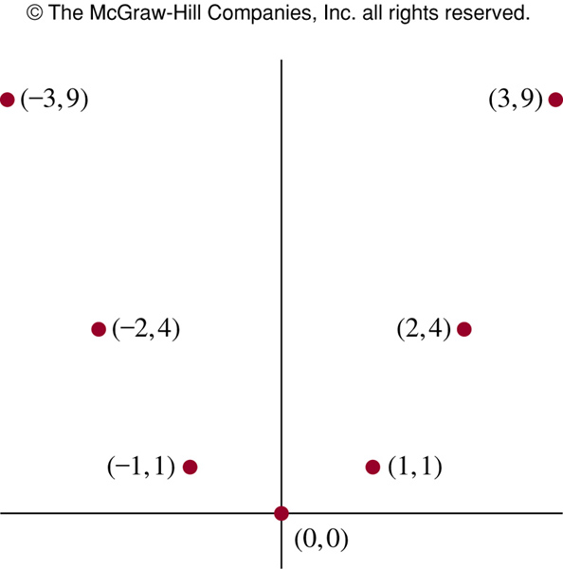
FIGURE 9 (2.3)
FIGURE 9 The Graph of f(x) = x² from Z to Z.
歐亞書局
P. 142
Notes:
p:\msoffice\My Projects\Rosen 6e 2007\Imagebank\JPEGs07-24-06\ch02\jpeg\02-3-009.jpg

Slide 78
Graphs of Functions
Definition 12: The floor function assigns to x the largest integer that is less than or equal to x (⎣x⎦ or [x]). The ceiling function assigns to x the smallest integer that is greater than or equal to x (⎡x⎤).

Slide 79
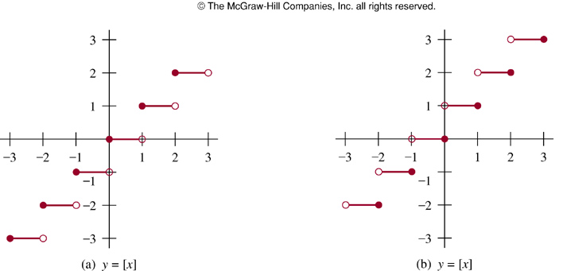
FIGURE 10 (2.3)
FIGURE 10 Graphs of the (a) Floor and (b) Ceiling Functions.
歐亞書局
P. 143
Notes:
p:\msoffice\My Projects\Rosen 6e 2007\Imagebank\JPEGs07-24-06\ch02\jpeg\02-3-010.jpg

Slide 80
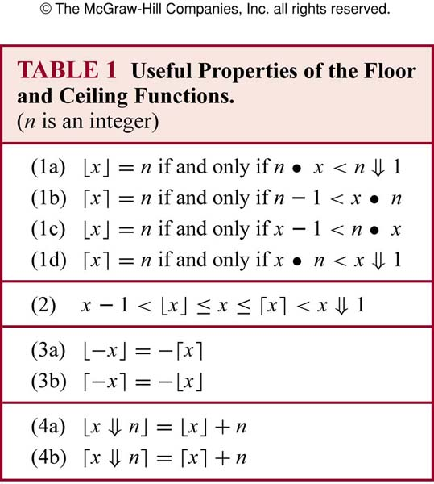
TABLE 1 (2.3)
歐亞書局
P. 144
Notes:
p:\msoffice\My Projects\Rosen 6e 2007\Imagebank\JPEGs07-24-06\ch02\jpeg\t02-3-01.jpg

